Slide 1
Schema Refinement and Normal Forms
Notes:
1
The slides for this text are organized into chapters. This lecture covers Chapter 19, on formal, dependency-driven database design..
Integrity constraints, in particular functional dependencies, play an important role in the design of database schemas. In particular, they can shed light on potential redundancies (and the problems that go with redundancy) in a relational schema. Typically, they are used to analyze the relational schema obtained by converting an ER diagram.
This chapter can be covered any time after the Foundations material (Chapters 1 to 5) is covered, at the instructor’s discretion. A good choice is to cover it after presenting all the implementation related material that is included in a course. This will allow a design sequence consisting of Chapters 19 and 20, and will enable the instructor to bring out the fact that design involves both redundancy analysis and performance considerations, and that these concerns should go hand-in-hand.

Slide 2
Database Design
Requirements Analysis
Conceptual Modeling (ER Model)
Logical Modeling (Relational Model)
Schema Refinement (Normalization)

Slide 3
Database Design
Redundancy
Schema Refinement
  Minimizing Redundancy
  Functional Dependencies (FDs)
  Normalization using FDs
    First Normal Form (1NF)
    Second Normal Form (2NF)
    Third Normal Form (3NF)
    Boyce-Codd Normal Form (BCNF)

Slide 4
Redundancy
Same information appears at many places in the DB
Problems:
  Wastage of Space
  Update Anomalies
    Update Anomaly
    Insert Anomaly
    Delete Anomaly
Normalization is done for “minimizing” redundancy

Slide 5
Redundancy
Storing the same information in more than one place within a database
Redundant Storage: Some information is stored repeatedly
Update Anomalies : Inconsistencies are created unless each and every copy of the data is updated
Insertion Anomalies: It may not be possible to store certain information unless storing some other, unrelated, information as well
Deletion Anomalies: It may not be possible to delete certain information without loosing some other, unrelated, information as well

Slide 6
Anomalies
Instructor( Instr_ID, Instr_name, Course, Credit)
Redundacy: Same course can be taught by several instructors, each time the credit for such course is repeated
Update Anomaly: Update information that DBMS from Semester I, 2008-2009 is 5 units course
Insert Anomaly: Cannot insert a new course credit unless an instructor is assigned to it
  Inversely - Cannot insert an instructor information unless he/she is assigned to a course to teach
Delete Anomaly: Last instructor available for teaching a course say Semantic Approaches leaves institute. The information that this course is a 5 credit course is also lost

Slide 7

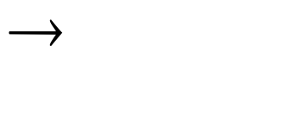
Example: Constraints on Entity Set
Consider relation obtained from Hourly_Emps:
  Hourly_Emps (ssn, name, lot, rating, hrly_wages, hrs_worked)
Notation: We will denote this relation schema by listing the attributes: SNLRWH
  This is really the set of attributes {S,N,L,R,W,H}.
  Sometimes, we will refer to all attributes of a relation by using the relation name. (e.g., Hourly_Emps for SNLRWH)
Some FDs on Hourly_Emps:
  ssn is the key: S SNLRWH
  rating determines hrly_wages: R W
Notes:
16

Slide 8
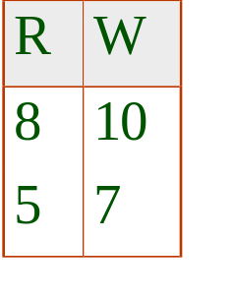
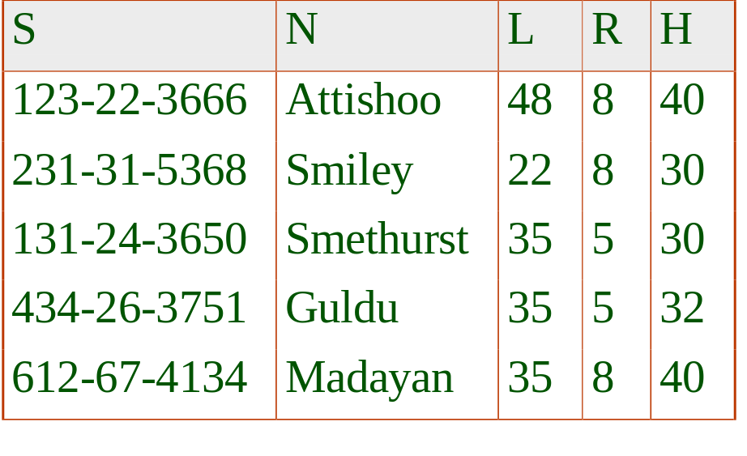

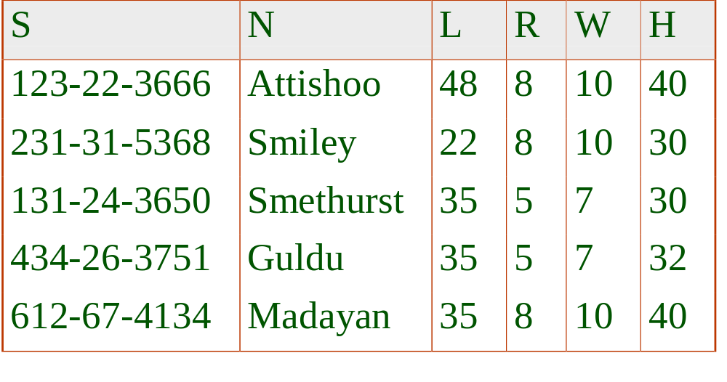
Example (Contd.)
Wages
Hourly_Emps2
Problems due to R W :
  Update anomaly: Can we change W in just the 1st tuple of SNLRWH?
  Insertion anomaly: What if we want to insert an employee and don’t know the hourly wage for his rating?
  Deletion anomaly: If we delete all employees with rating 5, we lose the information about the wage for rating 5!
Notes:
17

Slide 9
Solution
Decompose the relation:
  Hourly_Emps (ssn, name, lot, rating, hrly_wages, hrs_worked)
  Into set of relations:
  Hourly_Emps(ssn,name,lot,rating, hours_worked)
  Rating_Wages( rating,hrly_wages)
What happened to update anomalies?
We need to find out the basis for decomposing a relation to get rid of update anomalies

Slide 10
The Evils of Redundancy
Redundancy is at the root of several problems associated with relational schemas:
  redundant storage, insert/delete/update anomalies
Integrity constraints, in particular functional dependencies, can be used to identify schemas with such problems and to suggest refinements.
Main refinement technique: decomposition (replacing ABCD with, say, AB and BCD, or ACD and ABD).
Decomposition should be used judiciously:
  Is there reason to decompose a relation?
  What problems (if any) does the decomposition cause?
Notes:
14

Slide 11
Functional Dependency
FD is a many-to-one relationship from one set attributes to another
Example: there is a FD from the set of attributes {S#,P#} to the set of attributes {QTY}
For any given value for pair of attributes S# and P#, there is just one corresponding value of attribute QTY, but, many distinct values of the pair of attributes S# and P# can have the same corresponding value for attribute QTY

Slide 12
Functional Dependencies
Constraints on the set of legal relations
Require that the value for a certain set of attributes determines uniquely the value for another set of attributes
A functional dependency is a generalization of the notion of a key

Slide 13
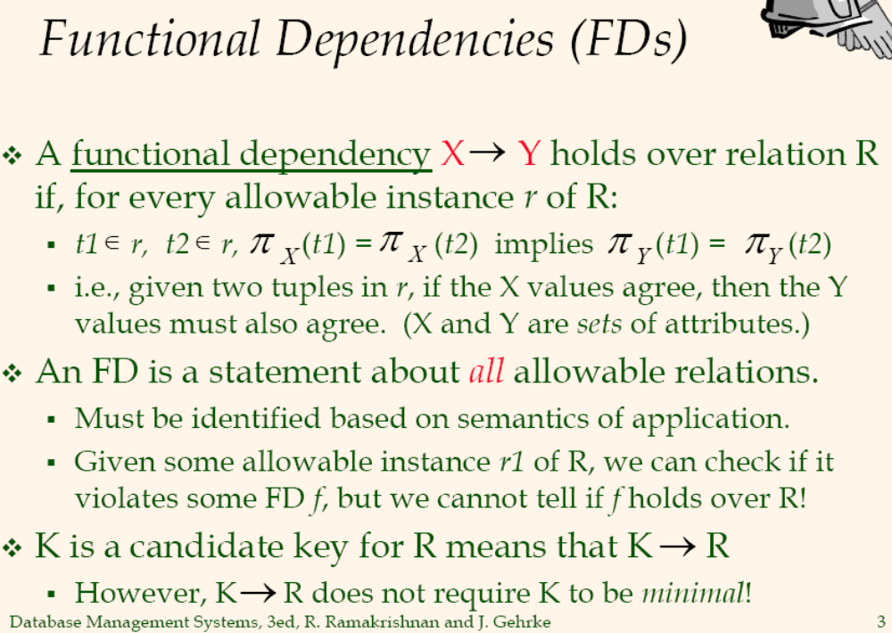
9/24/2011

Slide 14
Reasoning About FDs
  Given some FDs, we can usually infer additional FDs:
    ssn → did, did → lot implies ssn → lot
An FD f is implied by a set of FDs F if f holds whenever all FDs in F hold.
  closure of F is the set of all FDs that are implied by F
  It is constraint in the real world and hence be obeyed
  Declare FD and make sure that it is followed (integrity constraint)
Notes:
19

